Slide 1
Climate Change Science and Animal Agriculture: The Overlooked Vulnerability in Global Food Security
Eugene S. Takle
Professor
Department of Agronomy
Department of Geological and Atmospheric Science
Director, Climate Science Program
Iowa State University
Ames, IA 50011
Animal Science Department
Iowa State University
Ames, IA
13 January 2012

Slide 2
For a copy of this presentation…
See me afterwards, or
Google
Eugene Takle
and go to:
Public Powerpoint
Presentations

Slide 3
Outline
Observed global changes in carbon dioxide and temperature
Projected future changes in global and US temperatures and precipitation
Adaptation to climate change already is happening
Animal agriculture and climate change
Overlooked?

Slide 4
Climate change is one of the most important issues facing humanity
The scientific evidence clearly indicates that our climate is changing, and that human activities have been identified as a dominant contributing cause.
Notes:
No disagreement in peer reviewed literature
Powerful statements from every major professional science society and organization in the world
Powerful statements from the National Academies of Sciences (the leadership in science) for every major country
G8 + 5 other countries, May 2009: “The need for urgent action to address climate change is now indisputable.”

Slide 5
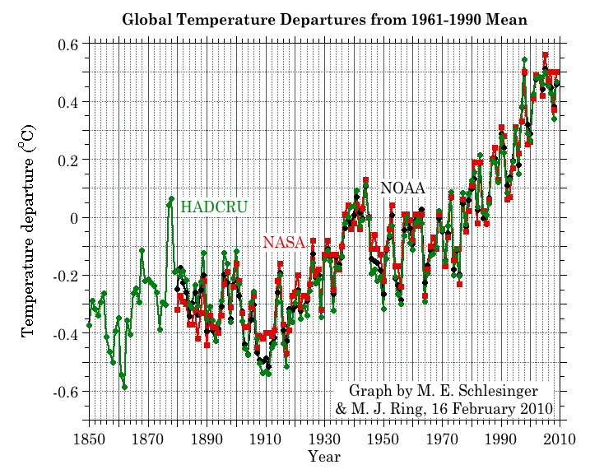
Three separate analyses of the temperature record – Trends are in close agreement

Slide 6
Three separate analyses of the temperature record – Trends are in close agreement
Richard Muller, UC Berkeley physicist and climate skeptic analyzed 1.9 billion temperature observations over 39,000 locations and concluded that NOAA, NASA, and HadCRU got it right.
Wall Street Journal Oct 2011

Slide 7
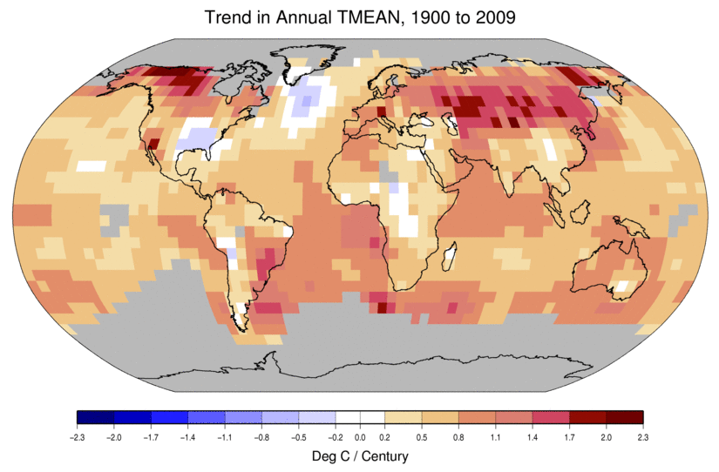
Temperature Changes are Not Uniform Around the Globe
From Tom Karl, NOAA NCDC

Slide 8
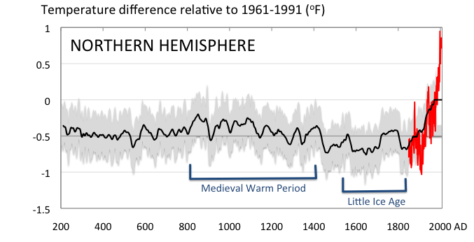
Conditions today are unusual in the context of the last 2,000 years …
Don Wuebbles

Slide 9
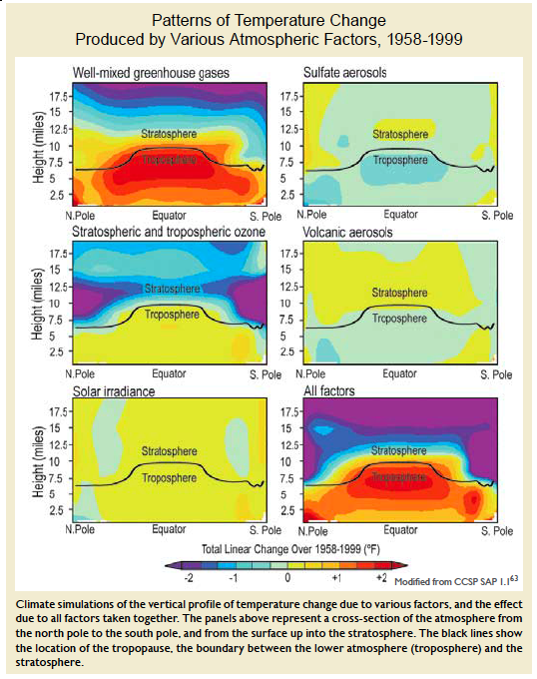
Warming of the Lower and Upper Atmosphere Produced by Natural and Human Causes
Karl, T. R., J. M. Melillo, and T. C. Peterson, (eds.), 2009: Global Climate Change Impacts in the United States. Cambridge University Press, 2009, 196pp.

Slide 10
Warming of the Lower and Upper Atmosphere Produced by Natural and Human Causes
Note that greenhouse gases have a unique temperature signature, with strong warming in the upper troposphere, cooling in the lower stratosphere and strong warming at the surface over the North Pole. No other warming factors have this signature.
Karl, T. R., J. M. Melillo, and T. C. Peterson, (eds.), 2009: Global Climate Change Impacts in the United States. Cambridge University Press, 2009, 196pp.

Slide 11
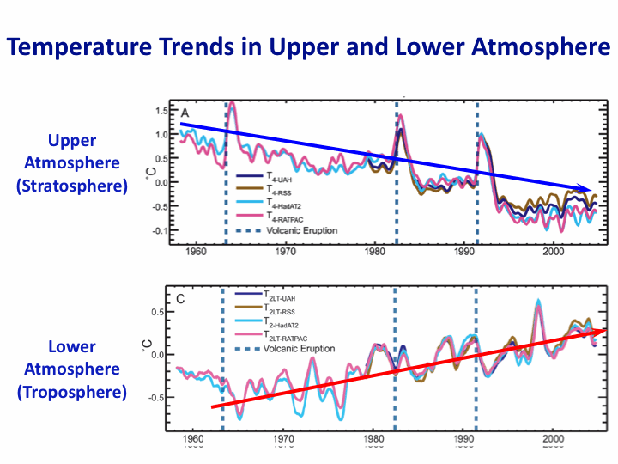
Warming of the Lower and Upper Atmosphere Produced by Natural and Human Causes
Note that greenhouse gases have a unique temperature signature, with strong warming in the upper troposphere, cooling in the lower stratosphere and strong warming at the surface over the North Pole. No other warming factors have this signature.
Karl, T. R., J. M. Melillo, and T. C. Peterson, (eds.), 2009: Global Climate Change Impacts in the United States. Cambridge University Press, 2009, 196pp.

Slide 12
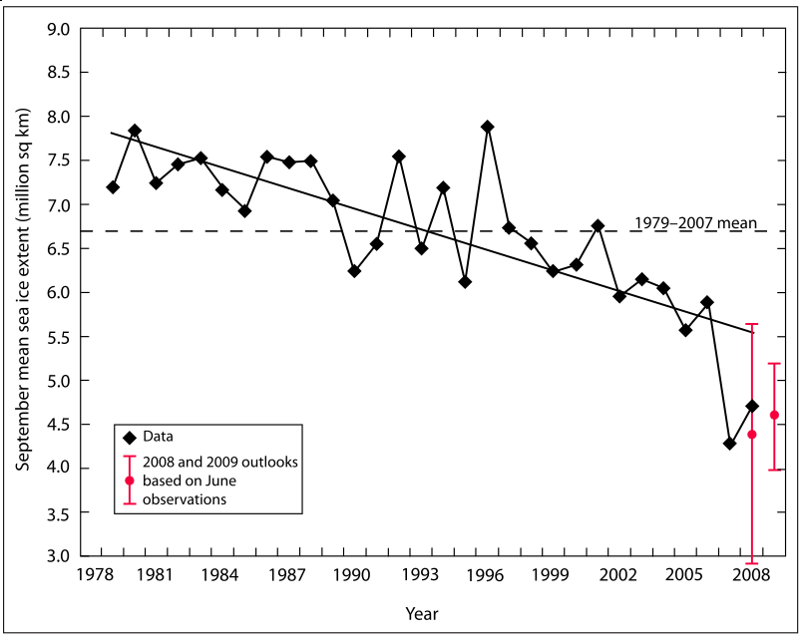
Warming of the Lower and Upper Atmosphere Produced by Natural and Human Causes
Note that greenhouse gases have a unique temperature signature, with strong warming in the upper troposphere, cooling in the lower stratosphere and strong warming at the surface over the North Pole. No other warming factors have this signature.

Slide 13
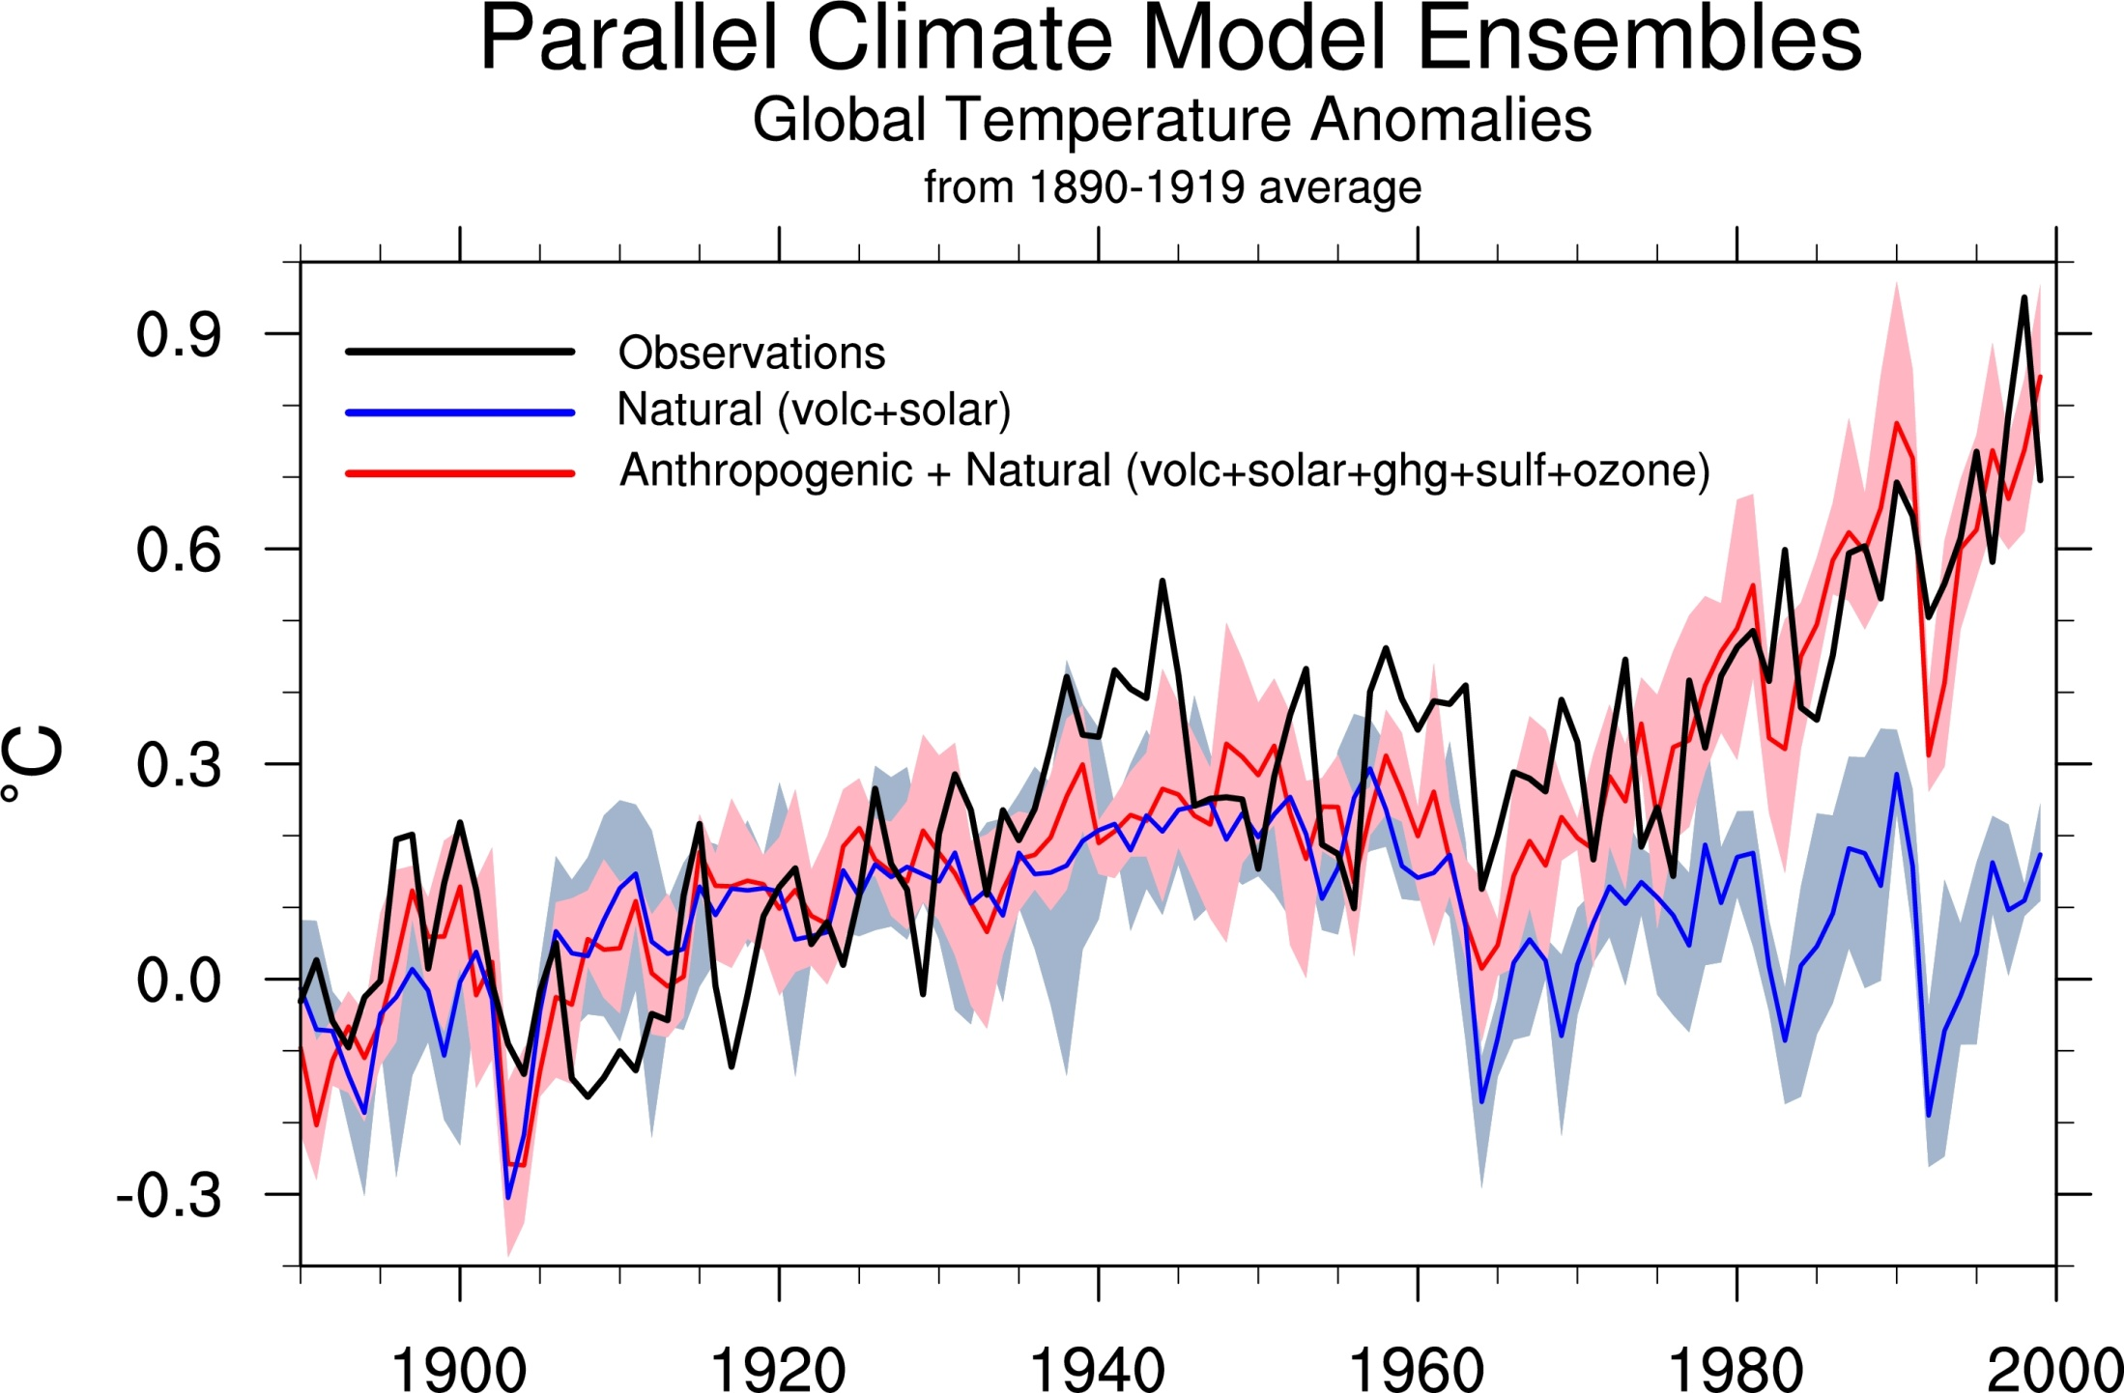
Climate models: Natural processes do not account for
observed 20th century warming after 1965

Slide 14
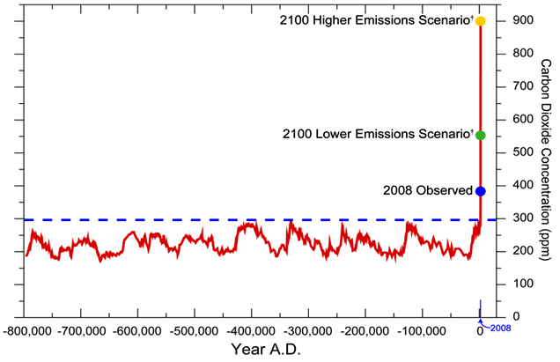
We have Moved Outside the Range of Historical Variation
800,000 Year Record of Carbon Dioxide Concentration
Don Wuebbles

Slide 15
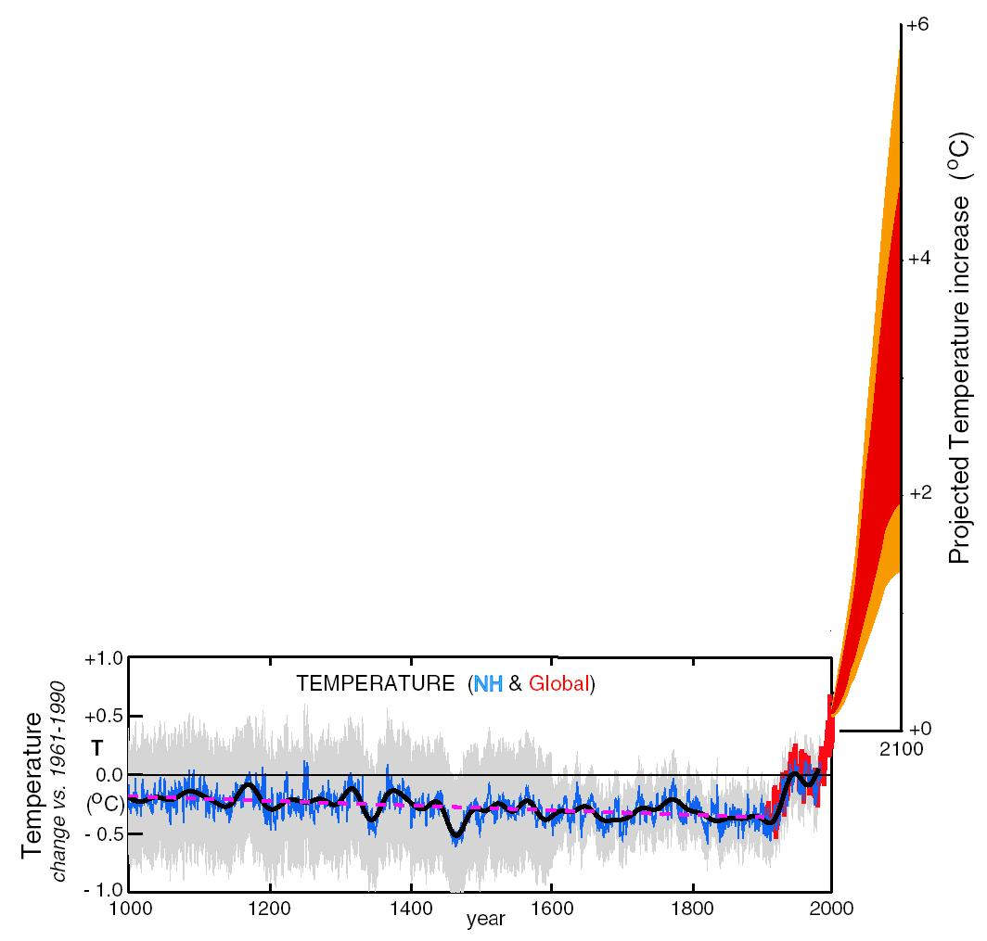
What can we expect in the future?
Don Wuebbles

Slide 16
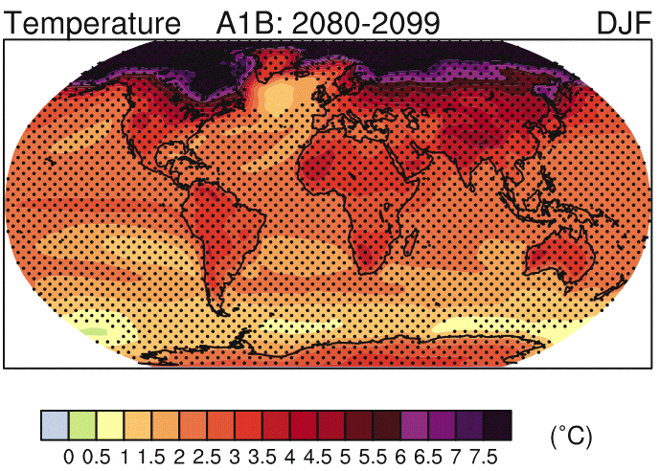
IPCC 2007

Slide 17
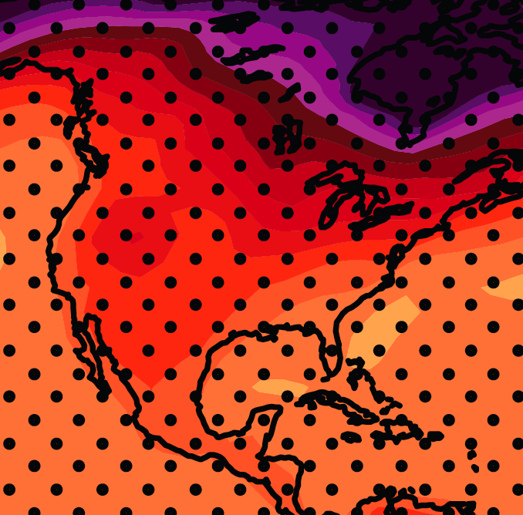
December-January-February Temperature Change
7.2ºF
6.3ºF
A1B Emission Scenario
2080-2099 minus1980-1999

Slide 18
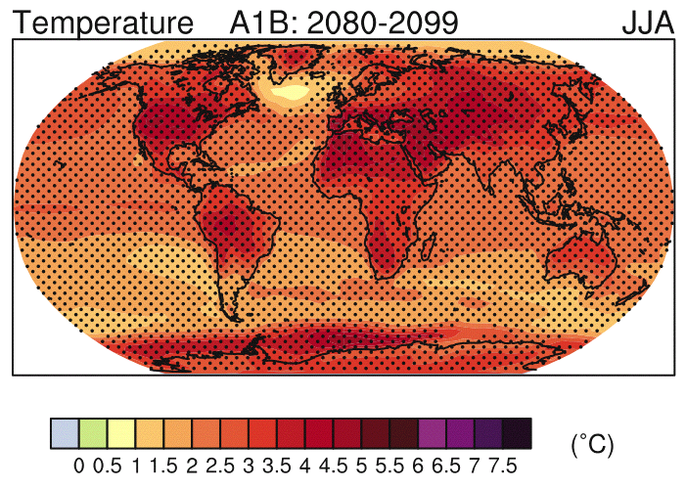
IPCC 2007

Slide 19
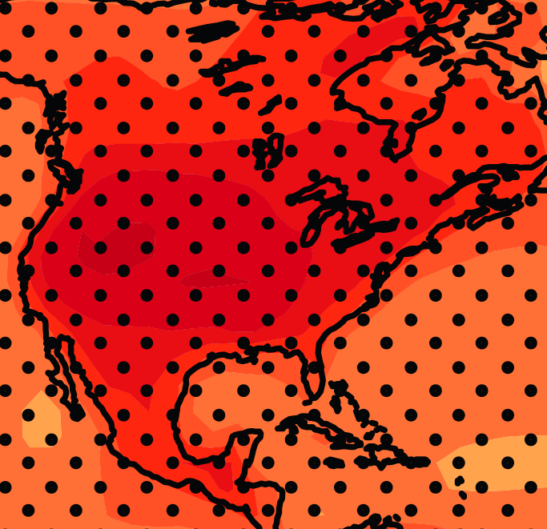
June-July-August Temperature Change
4.5ºF
5.4ºF
A1B Emission Scenario
2080-2099 minus1980-1999

Slide 20
June-July-August Temperature Change
4.5ºF
5.4ºF
A1B Emission Scenario
2080-2099 minus1980-1999
Not the direction of current trends

Slide 21
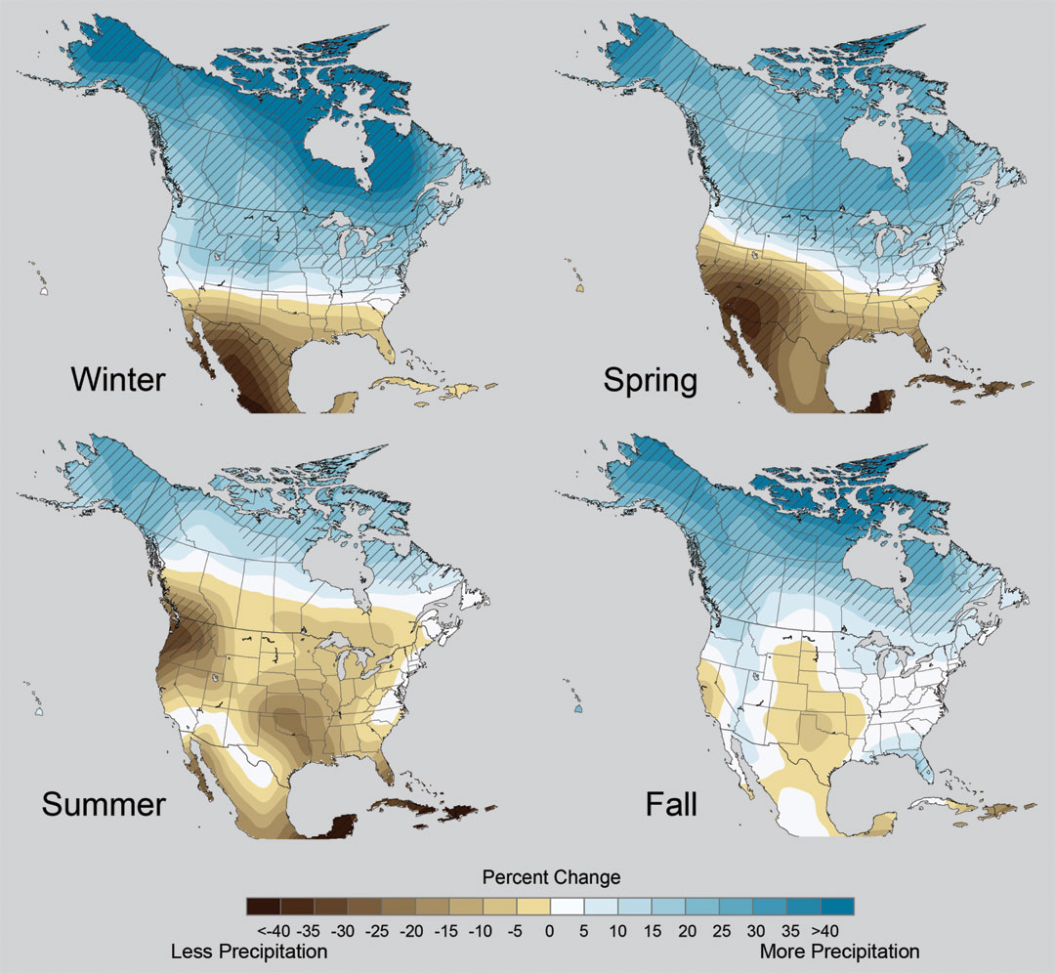
Projected Change in Precipitation: 2081-2099
Midwest: Increasing winter and spring precipitation, with drier summers
More frequent and intense periods of heavy rainfall
Unstippled regions indicate reduced confidence
Relative to 1960-1990
NOTE: Scale Reversed
Don Wuebbles

Slide 22
First Date Iowa’s Average Fall 4-inch Soil Temperature Was Below 50ºF
Iowa Environmental Mesonet 2010

Slide 23
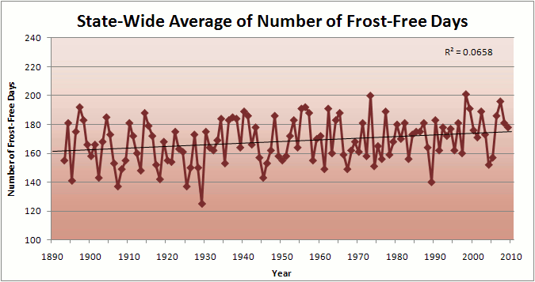
Iowa State-Wide Average Data

Slide 24
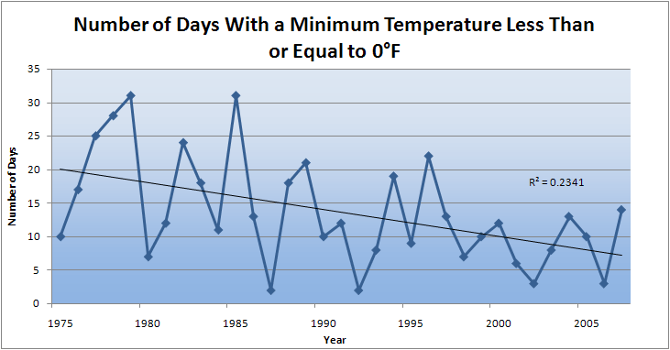
Des Moines Airport Data
Caution: Not corrected for urban heat island effects

Slide 25
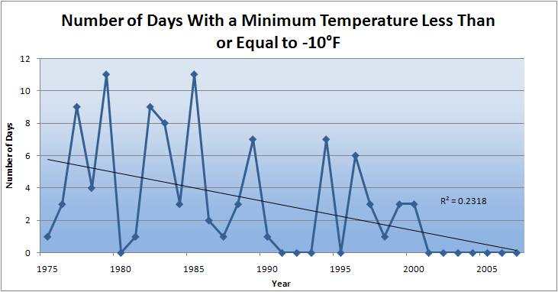
Des Moines Airport Data
Caution: Not corrected for urban heat island effects

Slide 26
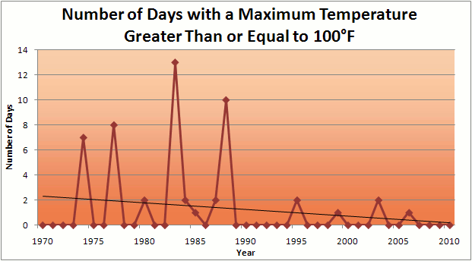
Des Moines Airport Data
1983: 13
1988: 10
1977: 8
1974: 7
2011: 0

Slide 27
Des Moines Airport Data
1983: 13
1988: 10
1977: 8
1974: 7
6 days ≥ 100ºF in the last 23 years
2011: 0

Slide 30
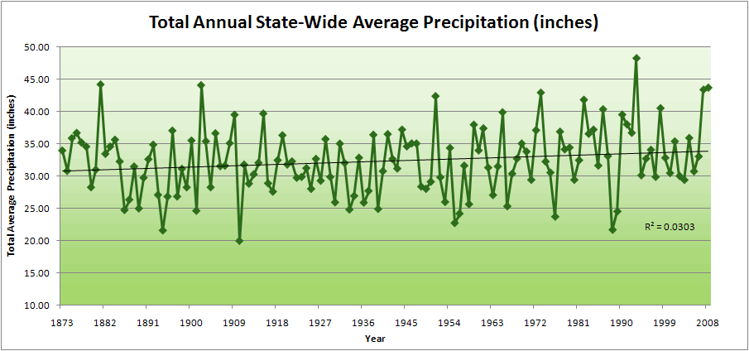
Iowa State-Wide Average Data

Slide 31
Iowa State-Wide Average Data
34.0”
10% increase
30.8”

Slide 32
Iowa State-Wide Average Data
Totals above 40”
2 years
34.0”
10% increase
30.8”

Slide 33
Iowa State-Wide Average Data
Totals above 40”
2 years
8 years
34.0”
10% increase
30.8”

Slide 34
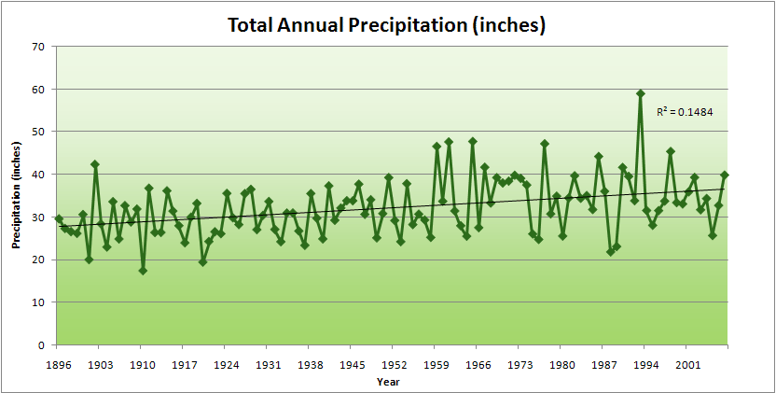
Cedar Rapids Data

Slide 35
Cedar Rapids Data
28.0”
32% increase
37.0”

Slide 36
Cedar Rapids Data
Years with more than 40 inches
11
1
28.0”
32% increase
37.0”

Slide 37
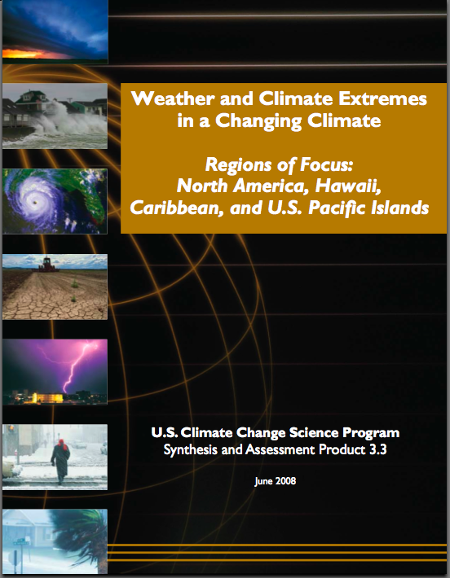
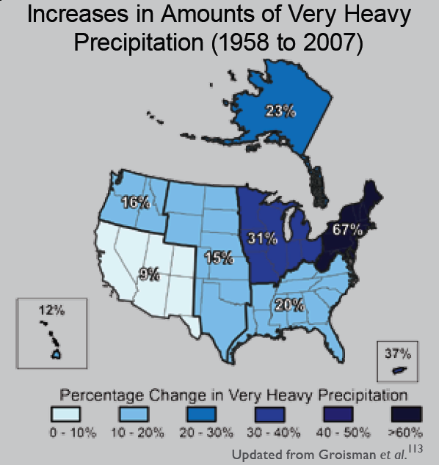
“One of the clearest trends in the United States observational record is an increasing frequency and intensity of heavy precipitation events… Over the last century there was a 50% increase in the frequency of days with precipitation over 101.6 mm (four inches) in the upper midwestern U.S.; this trend is statistically significant “
Karl, T. R., J. M. Melillo, and T. C. Peterson, (eds.), 2009: Global Climate Change Impacts in the United States. Cambridge University Press, 2009, 196pp.

Slide 38
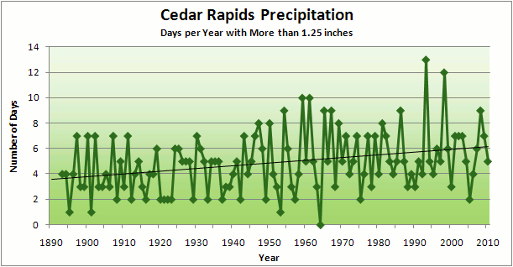
Cedar Rapids Data
3.6 days
67% increase
6.0 days

Slide 39
Cedar Rapids Data
Number of Years with More than 8 Occurrences
0
9
3.6 days
67% increase
6.0 days

Slide 40
Years with more than 40 inches: 43% Increase
2010 so far

Slide 41
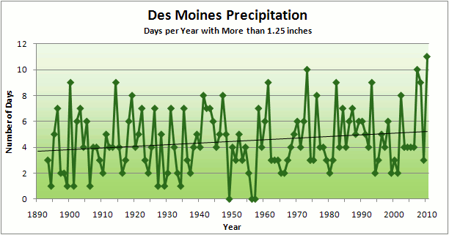
3.7
41% Increase
5.2

Slide 42
Number of Years with More than 8 Occurrences
2
7
3.7
41% Increase
5.2

Slide 43
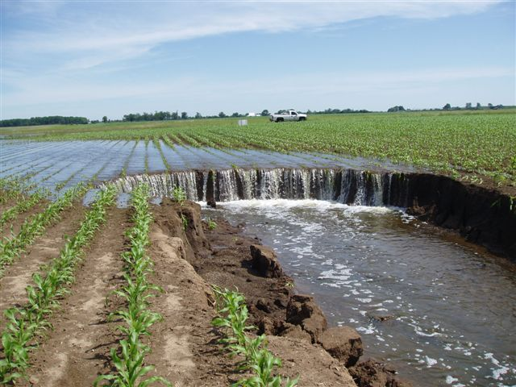
Photo courtesy of RM Cruse

Slide 44
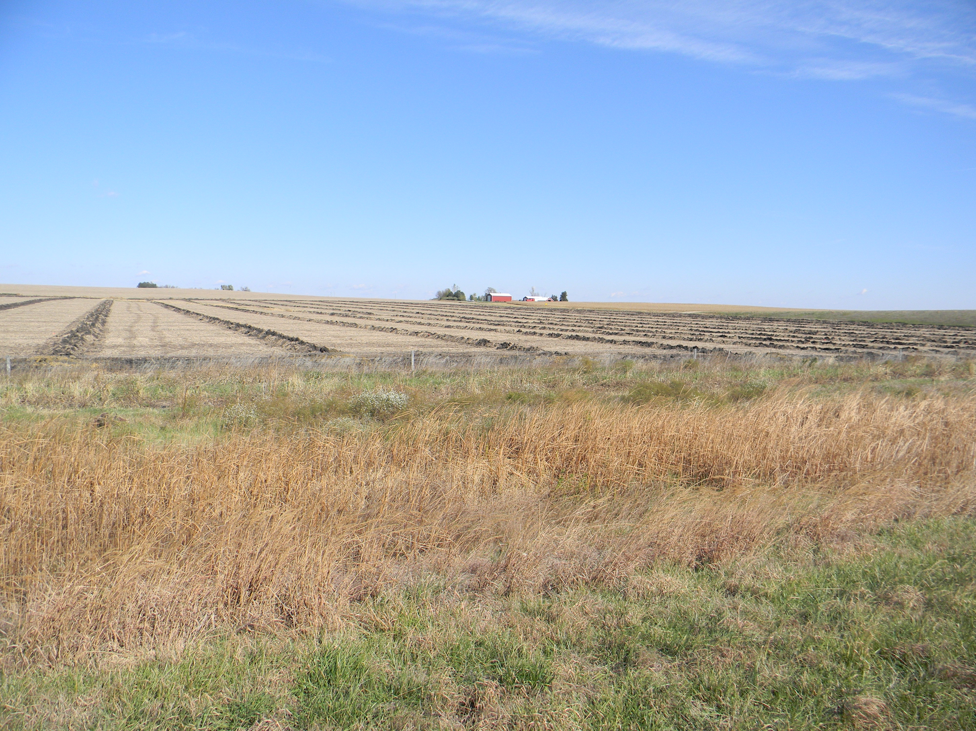

Slide 45
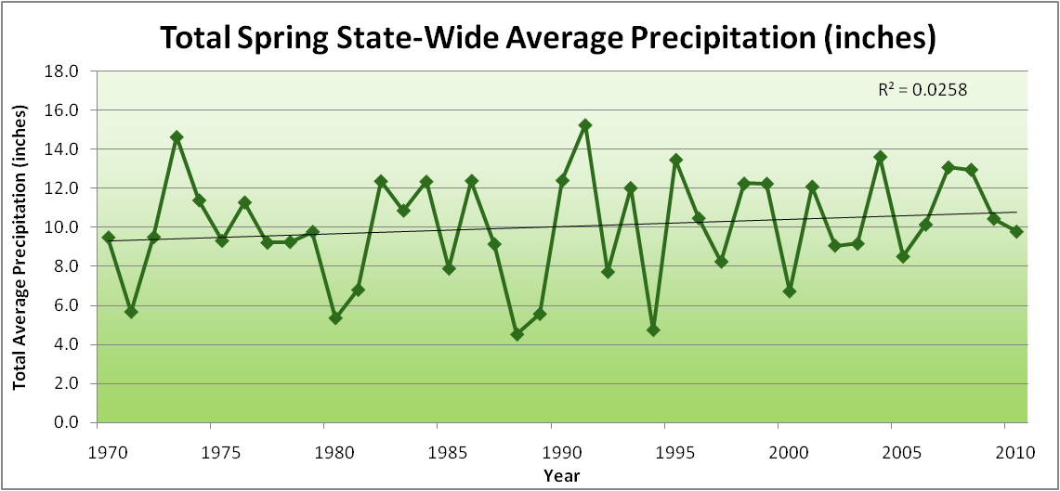
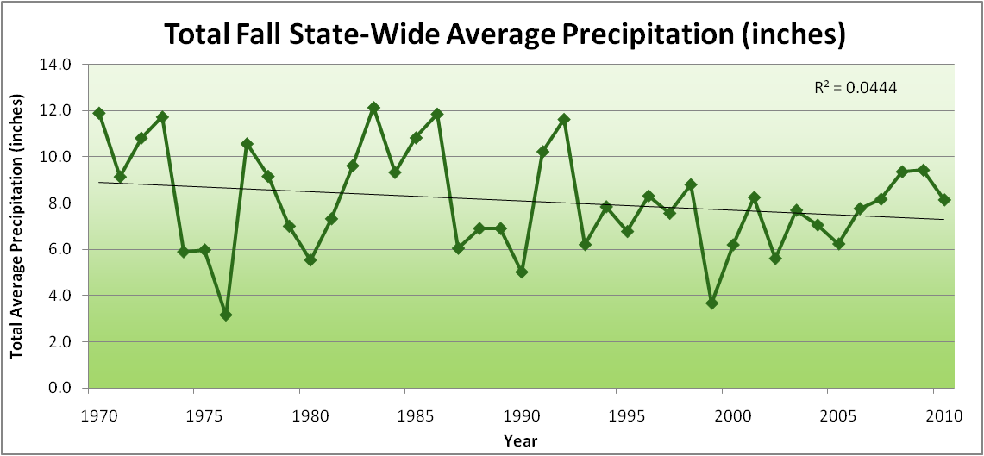
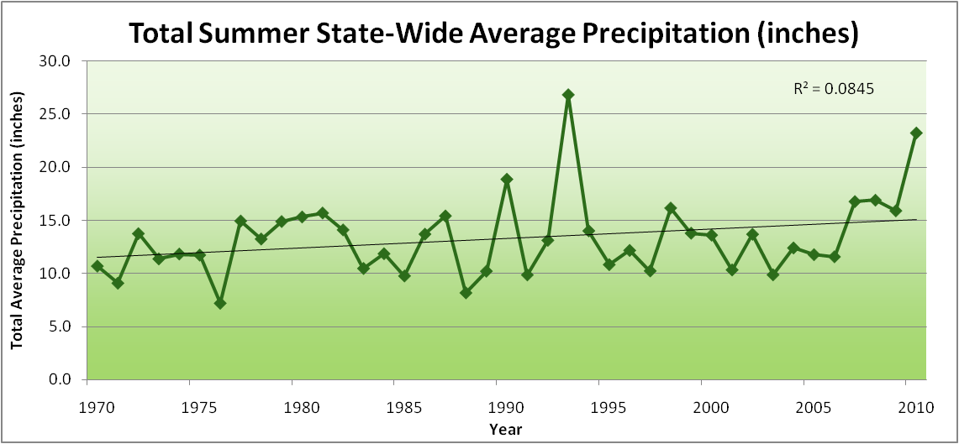
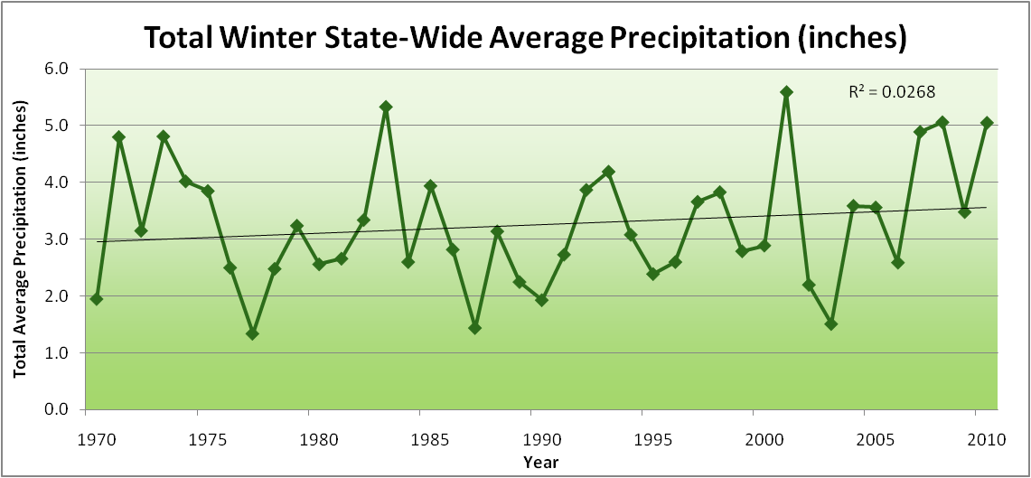
Amplification of the Seasonality of Precipitation
Spring
Fall
Summer
Winter

Slide 46
Amplification of the Seasonality of Precipitation
Spring
Fall
Summer
Winter

Slide 47
Amplification of the Seasonality of Precipitation
Spring
Fall
21.2 => 25.3 inches (22% increase)
12.1 => 10.5 inches (13% decrease)
Summer
Winter

Slide 48
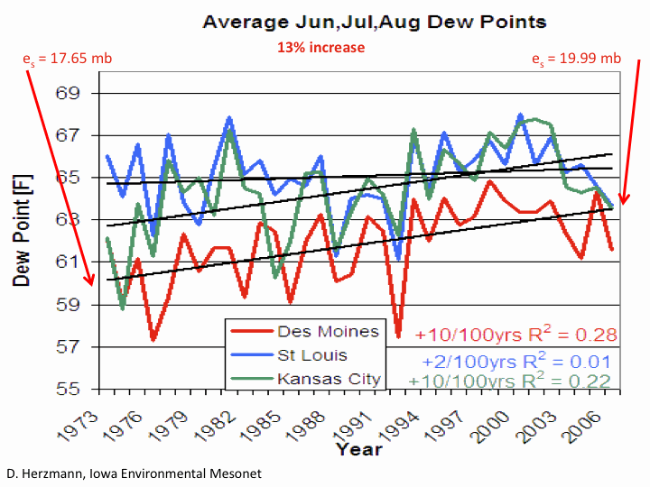

Slide 49
Climate trends of the recent past have low statistical significance. Nevertheless, they have forced significant adaptation for Iowa farmers and communities:

Slide 50
Climate trends of the recent past have low statistical significance. Nevertheless, they have forced significant adaptation for Iowa farmers and communities:
Even climate trends of low statistical significance can have impacts of high significance to Iowa agriculture and communities

Slide 51
Iowa Agricultural Producers are Adapting to Climate Change:
Longer growing season: plant earlier, plant longer season hybrids, harvest later
Wetter springs: larger machinery enables planting in smaller weather windows
More summer precipitation: higher planting densities for higher yields
Wetter springs and summers: more subsurface drainage tile is being installed, closer spacing, sloped surfaces
Fewer extreme heat events: higher planting densities, fewer pollination failures
Higher humidity: more spraying for pathogens favored by moist conditions. more problems with fall crop dry-down, wider bean heads for faster harvest due to shorter harvest period during the daytime.
Drier autumns: delay harvest to take advantage of natural dry-down conditions, thereby reducing fuel costs
HIGHER YIELDS!!
Is it genetics or better climate? Likely some of each.

Slide 52
Other Agricultural Impacts:
Carbon dioxide fertilization in field studies: corn - little or none, soybeans – up to 14%
Waterlogged soils in spring: shallow root system more prone to disease, nutrient deficiencies and drought later on; delayed planting
More frequent rains: delayed fertilizer application, reduced hay quality
More intense rain events: more soil erosion, reduced hay quality
More humid conditions, dew: plant disease, sudden death syndrome
Higher CO2 favors C3 plants over C4 plants: weeds grow more vigorously, more invasive species
Water quality: loss of nitrate fertilizer, more sediment, runoff from manure application
Animal agriculture: reduced milk production, reduced weight gain, increased mortality, reduced egg production, reduced breeding success
Grain and forage quality: reduced protein content

Slide 53
Visioning Future Climate Change for Iowa

Slide 54
Visioning Future Climate Change for Iowa
You are here

Slide 55
Visioning Future Climate Change for Iowa
You are here
Today

Slide 56
Visioning Future Climate Change for Iowa
You are here
Today
Past

Slide 57
Visioning Future Climate Change for Iowa
You are here
Today
Past
Future

Slide 58
Visioning Future Climate Change for Iowa
You are here
?
Today
Past
Future

Slide 59
You be the scientist: For which hypothesis of the future can you find the most evidence?
?
Some Climate Variable (temp, precip, humid)
Today
Past
Future

Slide 60
You be the scientist: For which hypothesis of the future can you find the most evidence?
Some Climate Variable (temp, precip, humid)
Measured past
Today
Past
Future

Slide 61
You be the scientist: For which hypothesis of the future can you find the most evidence?
Some Climate Variable (temp, precip, humid)
Future will return to something in the past
Measured past
Today
Past
Future

Slide 62
You be the scientist: For which hypothesis of the future can you find the most evidence?
Future will be like average of the past
Some Climate Variable (temp, precip, humid)
Future will return to something in the past
Measured past
Today
Past
Future

Slide 63
You be the scientist: For which hypothesis of the future can you find the most evidence?
Future will be like today
Future will be like average of the past
Some Climate Variable (temp, precip, humid)
Future will return to something in the past
Measured past
Today
Past
Future

Slide 64
You be the scientist: For which hypothesis of the future can you find the most evidence?
Current trend will continue
Future will be like today
Future will be like average of the past
Some Climate Variable (temp, precip, humid)
Future will return to something in the past
Measured past
Today
Past
Future

Slide 65
You be the scientist: For which hypothesis of the future can you find the most evidence?
What does the best available science have to say?
Current trend will continue
Future will be like today
Future will be like average of the past
Some Climate Variable (temp, precip, humid)
Future will return to something in the past
Measured past
Today
Past
Future

Slide 66
You be the scientist: For which hypothesis of the future can you find the most evidence?
Based on climate models, climate scientists overwhelmingly agree that the future will be more extreme than today
Current trend will continue
Future will be like today
Future will be like average of the past
Some Climate Variable (temp, precip, humid)
Future will return to something in the past
Measured past
Today
Past
Future

Slide 67
You be the scientist: For which hypothesis of the future can you find the most evidence?
Future will be more extreme than today
Current trend will continue
Future will be like today
Future will be like average of the past
Some Climate Variable (temp, precip, humid)
Future will return to something in the past
Measured past
Today
Past
Future

Slide 68
You be the scientist: For which hypothesis of the future can you find the most evidence?
Some Climate Variable (temp, precip, humid)
Measured past
Today
Past
Future

Slide 69
Best Available Science
A Prudent View of the Future
Some Climate Variable (temp, precip, humid)
Measured past
Today
Past
Future

Slide 70
Future Challenges to Adaptation in the US Midwest (near term):
Wetter spring and early summer:
Continued challenges to early field work
More soil compaction
Delayed planting
More frequent and higher-intensity extreme rain events:
Water-logged soils
Lack of oxygen to roots
More ponding (rural roads are becoming levees)
Additional installation of subsurface tile drainage is inundating downstream urban areas
Loss of nitrogen
Higher daily average temperatures (due to higher night-time temperatures):
Differential acceleration of reproductive processes: pollination failure
During grain-filling periods leads to higher nighttime respiration and reduced grain weight
Loss of soil carbon
Increased humidity:
More pressure from pests and pathogens
Multiple stressors

Slide 71
Future Challenges to Adaptation in the US Midwest (long-term, occasional short-term):
Drought pattern from the west or south occasionally spills into Midwest:
Underlying warming of the last 40 years caused by rise in CO₂ that has been buffered by high evaporative and transpiration cooling is unmasked
High plant populations not sustainable on reduced moisture
Prairie fires
Wind erosion of soils
Overwintering of pests and pathogens formerly not able to survive extreme cold temperatures

Slide 72
Sustaining agricultural production without depleting natural resources will become increasingly difficulty with increasing levels of climate change

Slide 73
Adapting animal agriculture to climate change
Weight gain (genetics, nutrition, management)
Milk production (genetics, nutrition, management)
Egg production (genetics, nutrition, management)
Heat, humidity, freeze-thaw, snow
Disease, pests, pathogens (zoonosis)
Reproductive success
Nutrition (declining grain & forage quality)

Slide 74
Temperature-Humidity Index
THI = (Dry bulb temperature ºC) + (0.36* dew point temperature ºC) +41.2
THI threshold values:
- Dairy cows 72
Mild 72-79
Moderate 80-89
Severe 90-98
Dangerous >98
- Beef cattle 72 – 75
- Swine 72 – 74
- Poultry 70 – 78

Slide 75
Overlooked?
Impacts of climate change on animal agriculture need to be assessed
Role of animals in agricultural systems needs better clarification
Impacts of climate change on agricultural systems need to be assessed
What about global agriculture?

Slide 76
Climate Change “Hot Spots”
Giorgi, F, 2006: Climate change hot spots. Geophysical Research Letters, 33, L08707, doi:10.1029/2006GL025734, 2006

Slide 77
Summary
Global temperature trends of the 20th C cannot be explained on the basis of natural variation alone
Models that explain these trends, when projected into the future, indicate a 1.5-6.5ºC warming over the 21st C
Farmers are adapting to climate change
Animal agriculture is under-represented in discussions of impact of climate change on agriculture
The major challenge in producing food for a global society is to figure out how to manage the unavoidable (adaptation to climate change) while avoiding the unmanageable (mitgating future climate change)

Slide 78
For More Information:
Climate Science Program
Iowa State University
http://climate.engineering.iastate.edu/
gstakle@iastate.edu
Iowa Flood Center
University of Iowa
http://www.iowafloodcenter.org/
witold-krajewski@uiowa.edu

Slide 79
For More Information
Contact me directly:
gstakle@iastate.edu
Current research on regional climate and climate change is being conducted at Iowa State University under the Regional Climate Modeling Laboratory
http://rcmlab.agron.iastate.edu/
North American Regional Climate Change Assessment Program
http://www.narccap.ucar.edu/
For current activities on the ISU campus, regionally and nationally relating to climate change see the Climate Science Initiative website:
http://climate.engineering.iastate.edu/
Or just Google Eugene Takle

